Slide 1
Personal assistant
Maths in the workplace

Slide 2
How our teaching resources are designed for the classroom

Slide 3
I can understand how maths is used by personal assistants.

Slide 4
A percentage is a proportion of a whole.

Slide 5

Personal assistant
Time
Finance

Slide 6
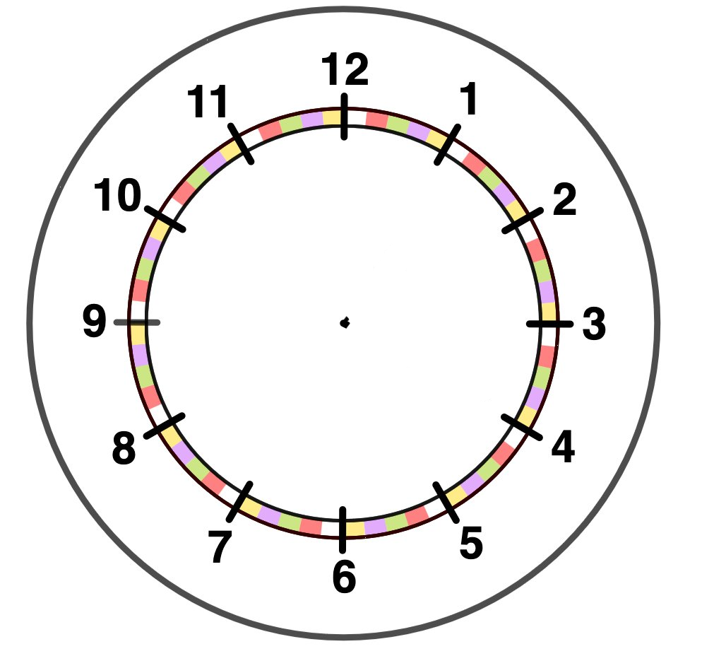


Time
What areas of maths do you think a personal assistant might use?
Time
Organising meetings
Booking travel
Coordinating plans
Spreadsheets
Finance
Booking accommodation
Using discounts (percentages)
Budgets
During this lesson we will look at some of these.

Slide 7
Time
A personal assistant (PA) is organising attendance at a conference.
The conference starts at 9 am.
If they need to leave home before 6:30 am, they can spend the night before at a hotel close to the conference venue.
Using the following information on the next slide decide if they need a hotel room for the night before.

Slide 8
Time
The time taken to drive to train station A is 35 minutes.
The conference is close to station H.
The time taken to walk from station H to the venue is 6 minutes.
Will the PA need to book a hotel for the night before the conference?
A | 0658 | 0743 | 0838
B | 0715 | 0800 | 0855
C | 0733 | 0818 | 0913
D | 0747 | 0832 | 0927
E | 0800 | 0845 | 0940
F | 0814 | - | 0954
G | 0830 | - | 1010
H | 0846 | - | 1026
Yes, they will. To get to the venue for 9 am they need to catch the 0658 train from station A. Therefore, they need to leave home at 0623 which is before 0630.

Slide 9
Time
The PA needs to let a client know the earliest time a meeting can start.
They need to travel from station B to station E.
It will take 20 minutes to get from station E to the venue of the meeting.
What is the earliest time the meeting can start?
A | 0658 | 0743 | 0838
B | 0715 | - | 0855
C | 0733 | 0818 | 0913
D | 0747 | 0832 | -
E | - | 0845 | 0940
F | - | - | 0954
G | 0830 | - | 1010
H | 0846 | - | 1026
The first train doesn’t stop at station E.
The second train doesn’t stop at station B.
They will need to catch the 0855 train from station B which gets to station E at 0940.
Therefore, the earliest time the meeting can start is 10 am.

Slide 10
Time
The PA of a director is organising a morning of interviews for a new position at the company.
Each candidate needs to do the following:
15 minute welcome.
A tour of the company, can be done in a group or independently, and takes 45 minutes.
An interview, individually with the director, and takes 60 minutes.
A timed task, which can be split into two parts and takes 1 hour 30 minutes.
A break of 15 minutes.
There are 3 candidates.

Slide 11
Time
The PA decides to use a spreadsheet it make rearranging the events easier.
They use coloured blocks to make it easier to see if events overlap.
TIME | A | B | C
09:00 | WELCOME
09:15
09:30
09:45
10:00
10:15
10:30
10:45
11:00
TIME | A | B | C
11:15
11:30
11:45
12:00
12:15
12:30
12:45
13:00
TASK
INTERVIEW
TOUR
B

Slide 12
Time
They should start with the interview as these need to be individually and are carried out by the same person and therefore cannot overlap.
TIME | A | B | C
09:00 | WELCOME
09:15
09:30
09:45
10:00
10:15
10:30
10:45
11:00
TIME | A | B | C
11:15
11:30
11:45
12:00
12:15
12:30
12:45
13:00
INTERVIEW
Can the interviews occur at these times?
INTERVIEW
No, there is an overlap here.
INTERVIEW
TASK
INTERVIEW
TOUR
B

Slide 13
Time
They schedule the interviews like this.
Is this okay?
TIME | A | B | C
09:00 | WELCOME
09:15
09:30
09:45
10:00
10:15
10:30
10:45
11:00
TIME | A | B | C
11:15
11:30
11:45
12:00
12:15
12:30
12:45
13:00
INTERVIEW
Yes, they now do not overlap.
INTERVIEW
The PA finds this note on their desk. What change should be made to the schedule?
Please make sure I have a 30 minute break at some point between the interviews but not before 10:30
INTERVIEW

Slide 14
Time
Is the interview schedule okay now?
TIME | A | B | C
09:00 | WELCOME
09:15
09:30
09:45
10:00
10:15
10:30
10:45
11:00
TIME | A | B | C
11:15
11:30
11:45
12:00
12:15
12:30
12:45
13:00
Yes, the interviews do not overlap and the interviewer has a break from 11:15 until 11:45
INTERVIEW
Please make sure I have a 30 minute break at some point between the interviews but not before 10:30
INTERVIEW
INTERVIEW

Slide 15
Time
The tour is scheduled next as the task can be broken into two parts.
TIME | A | B | C
09:00 | WELCOME
09:15
09:30
09:45
10:00
10:15
10:30
10:45
11:00
TIME | A | B | C
11:15
11:30
11:45
12:00
12:15
12:30
12:45
13:00
And now the breaks of 15 minutes each.
TOUR
TOUR
INTERVIEW
INTERVIEW
B
B
B
INTERVIEW
TOUR
TOUR
B

Slide 16
Time
And, finally the task.
TIME | A | B | C
09:00 | WELCOME
09:15
09:30
09:45
10:00
10:15
10:30
10:45
11:00
TIME | A | B | C
11:15
11:30
11:45
12:00
12:15
12:30
12:45
13:00
The director would like a 15 minute get together with all of the candidates at the end of the morning.
What time will the interview morning finish?
TOUR
TOUR
INTERVIEW
TASK
TASK
INTERVIEW
B
B
B
The morning finishes at 1:00 pm
TASK
FAREWELL
INTERVIEW
TASK
TOUR

Slide 17
Time
TIME | A | B | C
09:00 | WELCOME
09:15
09:30
09:45
10:00
10:15
10:30
10:45
11:00
TIME | A | B | C
11:15
11:30
11:45
12:00
12:15
12:30
12:45
13:00
The director decides that they would like each candidate to take the tour on their own rather than with another candidate and all the candidates need to have a break before 10:30.
Rewrite the schedule to take this into account.
Remember the task can be split into two parts.
TOUR
TOUR
INTERVIEW
TASK
TASK
INTERVIEW
B
B
B
FAREWELL
INTERVIEW
TASK
TOUR

Slide 18
Time
TIME | A | B | C
09:00 | WELCOME
09:15
09:30
09:45
10:00
10:15
10:30
10:45
11:00
TIME | A | B | C
11:15
11:30
11:45
12:00
12:15
12:30
12:45
13:00
The director decides that they would like each candidate to take the tour on their own rather than with another candidate and all the candidates need to have a break before 10:30.
Rewrite the schedule to take this into account.
Remember the task can be split into two parts.
TOUR
TOUR
TASK
INTERVIEW
TASK
INTERVIEW
B
B
TASK
B
FAREWELL
INTERVIEW
TASK
TOUR

Slide 19
Time
1) The PA needs to let a client know the earliest time a meeting can start.
They need to travel from station C to station G.
It will take 20 minutes to get from station G to the venue of the meeting.
What is the earliest time the meeting can start?
A | 0658 | 0743 | 0838
B | 0715 | - | 0855
C | - | 0818 | 0913
D | 0747 | 0832 | -
E | - | 0845 | 0940
F | - | - | 0954
G | 0830 | - | 1010
H | 0846 | - | 1026

Slide 20
Time
2) You are a PA and are organising a morning of interviews. You may use the spreadsheet (next slide) to help you.
Each candidate needs to do the following:
15 minute welcome.
A tour of the company, in pairs, which takes 30 minutes.
An interview, individually with the director, which takes 45 minutes.
A timed task, which can be split into multiple parts and takes 60 minutes.
A paired task, which takes 45 minutes.
A break of 15 minutes with one other candidate, no earlier than 10:30.
The director wants a 15 minute break after 2 interviews.
There are 4 candidates.

Slide 21
Time
TIME | A | B | C | D
09:00
09:15
09:30
09:45
10:00
10:15
10:30
10:45
11:00
TIME | A | B | C | D
11:15
11:30
11:45
12:00
12:15
12:30
12:45
13:00

Slide 22
Time
1) The PA needs to let a client know the earliest time a meeting can start.
They need to travel from station C to station G.
It will take 20 minutes to get from station G to the venue of the meeting.
What is the earliest time the meeting can start?
A | 0658 | 0743 | 0838
B | 0715 | - | 0855
C | - | 0818 | 0913
D | 0747 | 0832 | -
E | - | 0845 | 0940
F | - | - | 0954
G | 0830 | - | 1010
H | 0846 | - | 1026
The first train doesn’t stop at station C.
The second train doesn’t stop at station G.
They will need to catch the 0913 train from station C which gets to station G at 1010.
Therefore, the earliest time the meeting can start is 10:30 am.

Slide 23
Time
2) You are a PA and are organising a morning of interviews. You may use the spreadsheet (next slide) to help you.
Each candidate needs to do the following:
15 minute welcome.
A tour of the company, in pairs, which takes 30 minutes.
An interview, individually with the director, which takes 45 minutes.
A timed task, which can be split into multiple parts and takes 60 minutes.
A paired task, which takes 45 minutes.
A break of 15 minutes with one other candidate, no earlier than 10:30.
The director wants a 15 minute break after 2 interviews.
There are 4 candidates.

Slide 24
Time
TIME | A | B | C | D
09:00 | WELCOME
09:15 | I | T | TT | T
09:30
09:45 |  | TT |  | TT
10:00 | T | I | T
10:15
10:30 | B |  | B
10:45 | TT | B | TT | B
11:00 |  | PT | I | PT
TIME | A | B | C | D
11:15 | TT | PT | I | PT
11:30
11:45 | PT | TT | PT | I
12:00
12:15
12:30 | Farewell
12:45
13:00
Here is an example:
Key
I = interview
T = tour
TT = timed task
PT = paired task
B = break

Slide 25
Personal assistant
Time
Finance

Slide 26

Finance
A personal assistant needs to book accommodation for a 2 night stay.
Which hotel should they choose?
KIP HERE
£87 pn
GET YOUR HEAD DOWN
£98 pn
10% discount if you stay more than one night
A STAY AWAY
£91 pn
10% discount on your second night
KIP HERE
Total cost
= £87 × 2
= £174
GET YOUR HEAD DOWN
Total cost
= 0.9 × (£98 × 2)
= £176.40
A STAY AWAY
Total cost
= £91 + 0.9 × £91
= £172.90

Slide 27
Finance
A personal assistant needs to book accommodation for a 3 night stay.
Which hotel should they choose?
KIP HERE
£90 pn
GET YOUR HEAD DOWN
£98 pn
10% discount if you stay more than two nights
A STAY AWAY
£99 pn
10% discount on your second night
15% discount on your third night
KIP HERE
Total cost
= £90 × 3
= £270
GET YOUR HEAD DOWN
Total cost
= 0.9 × (£98 × 3)
= £264.60
A STAY AWAY
Total cost
= £99 + 0.9 × £99 + 0.85 × £99
= £272.25

Slide 28
Finance
An employee needs to travel from London to attend a meeting in Manchester.
They would like to drive but will only be able to do this if it is cheaper than using a train.
Compare the costs of the 2 different ways of travel.
If they drive they will be reimbursed at a rate of 45 p per mile.
If they catch the train they will need to use a taxi to and from each train station.
The taxis will cost £2.70 per mile.

Slide 29
Finance
The distance from London to Manchester is 210 miles.
Let’s start by calculating the cost of using a car.
Total distance travelled = 2 × 210 = 420 miles
Cost of using a car = 420 × 0.45 = £189
And now using a train.
Cost of return ticket from London to Manchester = £115
Distance travelled in taxis = 28 miles
Cost of taxis = 28 × £2.70 = £75.60
Total cost of using the train = £115 + £75.60 = £190.60
They can drive to the meeting.

Slide 30
Finance
Calculate the difference in cost of travelling by car and train/taxis.
Mileage for car use = 45 p per mile
Mileage cost for taxis = £2.70
The distance between Liverpool and Bristol is 180 miles.
Return train ticket £71.80
Miles travelled in taxis = 36 miles
Using a car = 360 × 0.45 = £162
Train and taxis = 71.80 + 36 × 2.70 = £169
Using a car is cheaper by £7

Slide 31
Finance
1) A personal assistant needs to book accommodation for a 3 night stay.
Which hotel should they choose?
KIP HERE
£105 pn
GET YOUR HEAD DOWN
£118 pn
10% discount if you stay more than two nights
A STAY AWAY
£115 pn
10% discount on your second night
15% discount on your third night

Slide 32
Finance
2) Calculate the difference in cost of travelling by car and train/taxis.
Mileage for car use = 45 p per mile
Mileage cost for taxis = £2.70
The distance between Exeter to Birmingham is 169 miles.
Return train ticket £108
Miles travelled in taxis = 16 miles

Slide 33
Finance
1) A personal assistant needs to book accommodation for a 3 night stay.
Which hotel should they choose?
KIP HERE
£105 pn
GET YOUR HEAD DOWN
£118 pn
10% discount if you stay more than two nights
A STAY AWAY
£115 pn
10% discount on your second night
15% discount on your third night
KIP HERE
Total cost
= £105 × 3
= £315
GET YOUR HEAD DOWN
Total cost
= 0.9 × (£118 × 3)
= £318.60
A STAY AWAY
Total cost
= £115 + 0.9 × £115 + 0.85 × £115
= £316.25

Slide 34
Finance
2) Calculate the difference in cost of travelling by car and train/taxis.
Mileage for car use = 45 p per mile
Mileage cost for taxis = £2.70
The distance between Exeter to Birmingham is 169 miles.
Return train ticket £108
Miles travelled in taxis = 16 miles
Using a car = 338 × 0.45 = £152.10
Train and taxis = 108 + 16 × 2.70 = £151.20
Using a train/taxi is cheaper by 90 pence.

Slide 35
Personal assistant
The main areas of maths a personal assistant uses are time and money.
Time
Organising meetings
Booking travel
Coordinating plans
Spreadsheets
Finance
Booking accommodation
Using discounts (percentages)
Budgets

Slide 36

© Oak National Academy 2024.
Produced in partnership with Mathematics in Education and Industry.
Licensed on the Open Government Licence v3.0, except where otherwise stated. See Oak terms and conditions.

